Slide 1

Achraf EL BACH 14/04/2022
Trinity College
Computer Science and Statistics
PROGRAMMING PROJECT
CSU11013

Slide 2
Data Parsing
DataPoint
Name : String
State : String
Status : String
Launch Date : Date (custom type)
Diameter : int
Mass : int
Perigee : double
Apogee : double
SpaceItem

Slide 3
Data Filtering
Six Object Filter (using the Comparator class):
Name (String Comparaison)
State (String Comparaison)
Date (Before and After comparaison)
Perigee (Double Comparaison)
Apogee (Double Comparaison)
Multiple can be used in the same query.
ObjectFilter

Slide 4
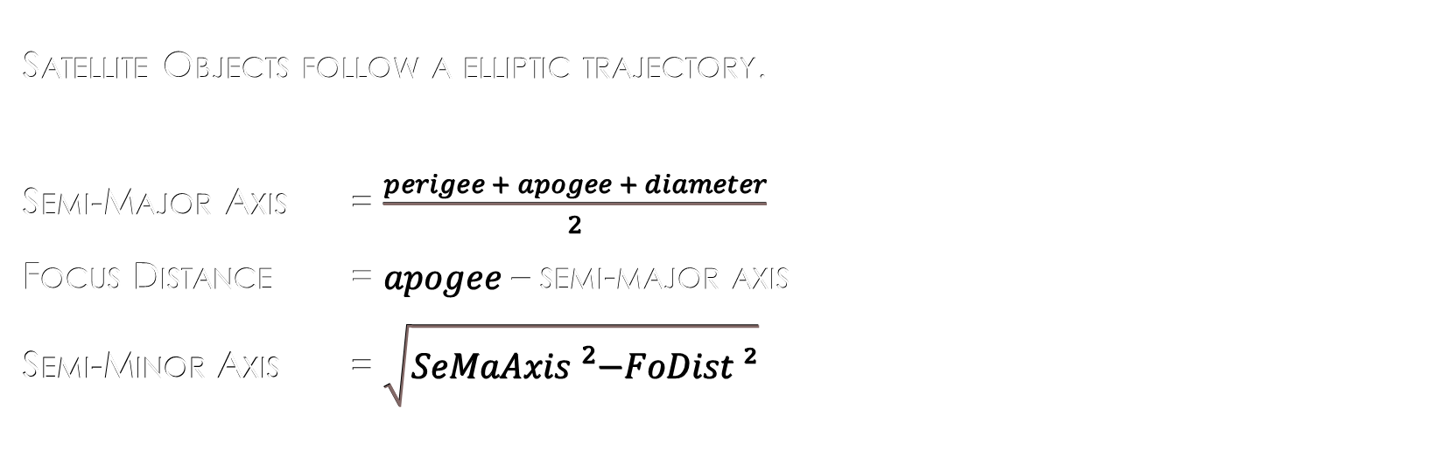
Trajectory Calculation
Satellite Objects follow a elliptic trajectory.
Semi-Major Axis = $\frac{perigee + apogee + diameter}{2}$
Focus Distance = $apogee$ – semi-major axis
Semi-Minor Axis = $\sqrt{SeMaAxis{}_{}^{2}−FoDist ²}$
SeMaAxis
FoDist
SeMiAxis

Slide 5
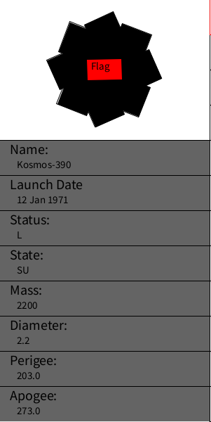
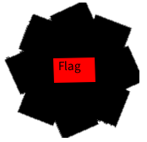
Information Box
Information card containing the object attributes.
Preview of the rotating object.
The object shown is the selected one.

Slide 6
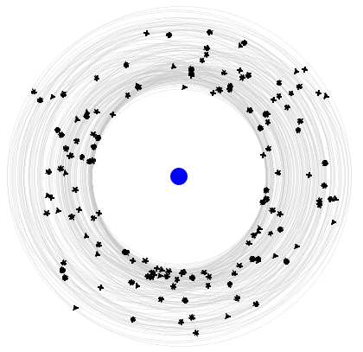
Earth Orbit System
Planet Earth
+
Every satellite’s orbits
+
Every satellite objects

Slide 7
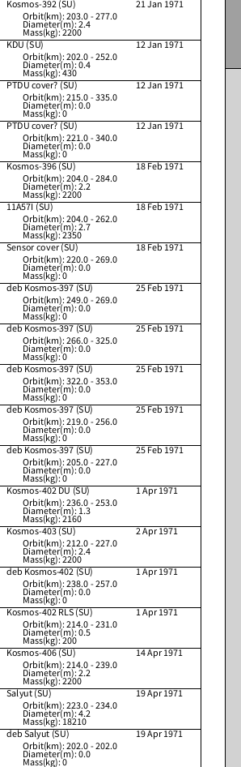

Object List
A detailed list of all the objects.
Each list item displays all the attributes.
Scrollbar to move along the list.
Mouse Wheel can also be used.

Slide 8
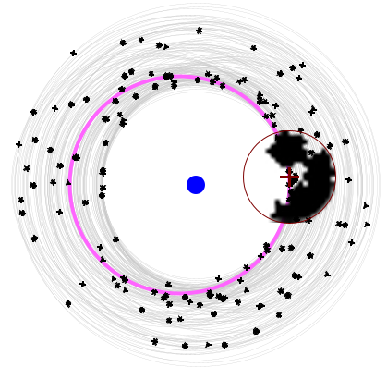
User Interaction
The user can click on the orbiting object to select it.
Closest Object to the cursor is chosen.
Zoomed zone on top of the cursor.
Crosshair on the cursor.
The object’s orbit will be highlighted in pink.

Slide 9

User Interaction
The user can click on a list item to select it.
The item will be highlighted with a red border.

Slide 10
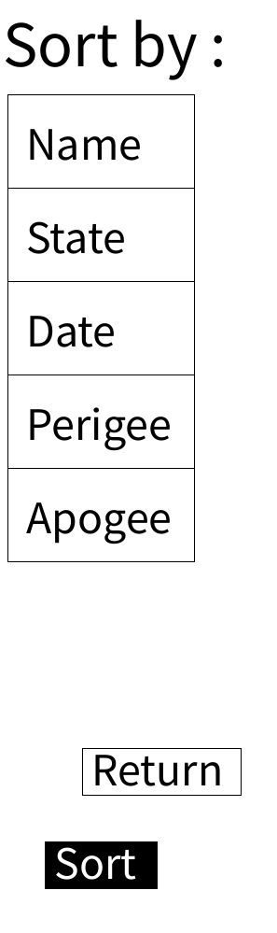

Sorting Button
Switches to the sorting screen.
Five buttons = Five sorting attributes
Button click order matters.
Sort button switches back to the sorted list.

Slide 11
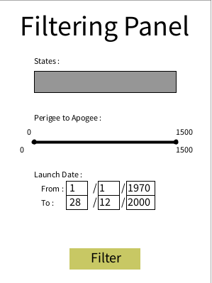
Filtering Panel
Can choose none, one or multiple states.
Can set distance away from earth from
0 to 1500 kilometers.
Can enter a date from
year 0 to the end of 2021.

Slide 12
Demonstration

